Slide 1

DriverPass System Analysis
Connor Martin
Notes:
[No speaker notes required for this slide.]

Slide 2

System Requirements
Functional Requirements:
Students can take online practice tests with instant feedback.
Students can schedule and manage driving lessons with instructors.
Nonfunctional Requirements:
Secure and encrypted handling of user data.
The system is available 99.9% of the time to ensure reliability.
Notes:
[In your speaker notes, include an explanation of the different requirements you determined for DriverPass’s system. What are the functional requirements you selected to describe? What are the nonfunctional requirements you selected to describe? Be sure to explain how these requirements meet DriverPass’s needs.]

Slide 3
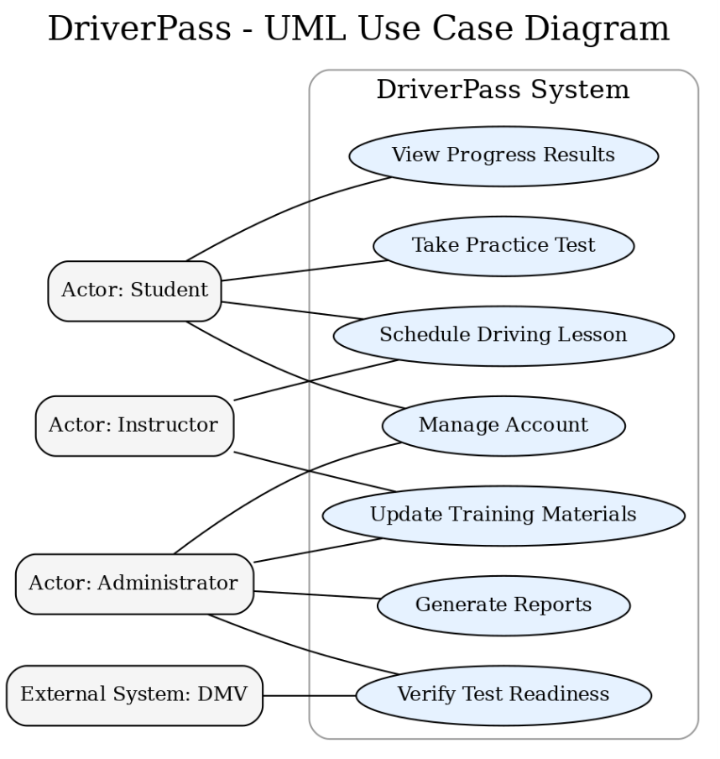
Use Case Diagram
Notes:
[Explain your diagram. Who are the different actors in the system? What are the different use cases? How did you account for DriverPass’s needs in your design? In your explanation, keep your audience in mind. Avoid the use of terms like “actors” and “use cases” in your explanation.]

Slide 4
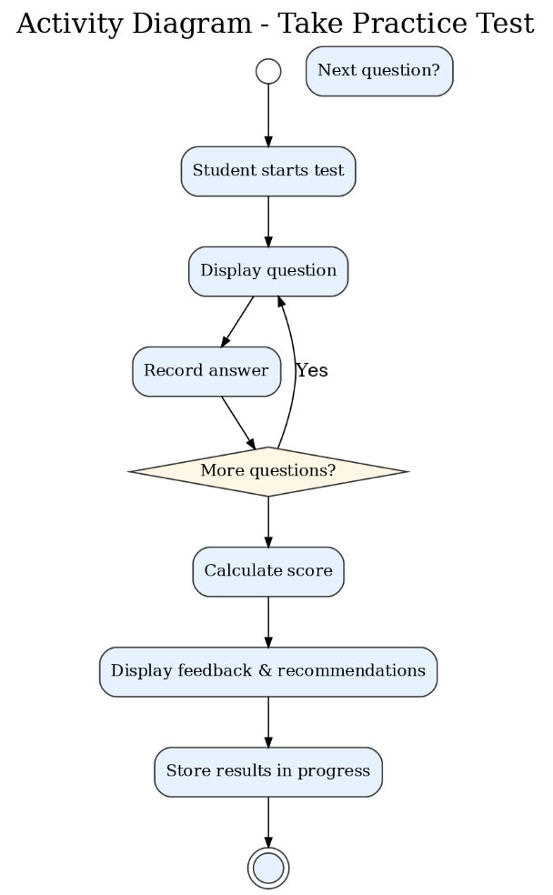
Activity Diagram
Notes:
[Explain your diagram. Which use case are you breaking down? What are the steps for this use case? How did you account for DriverPass’s needs in your design? In your explanation, keep your audience in mind. Avoid the use of technical terms such as “nodes,” “control flows,” and so on.]

Slide 5
Security
Bulleted List:
All data transfers use HTTPS encryption.
User authentication with secure password hashing.
Role-based access control for different user types.
Regular data backups and disaster recovery plan.
Notes:
[How did you consider security in your design? In your explanation, keep your audience in mind by avoiding the use of technical terms.]

Slide 6
System Limitations
Bulleted List:
Requires a stable internet connection for all functions.
Dependent on third-party DMV system for test readiness verification.
Scheduling depends on instructor availability.
Mobile app performance may vary on older devices.
Notes:
[What are the limitations of your design? In your explanation, keep your audience in mind by avoiding the use of technical terms.]

